Slide 1
HL Physics multiple choice questions
Nov 2011

Slide 2
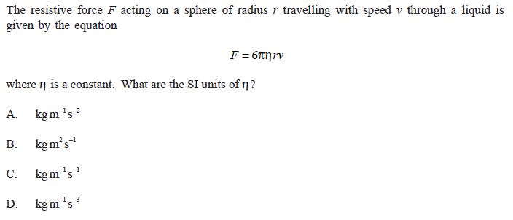
SI Units

Slide 3
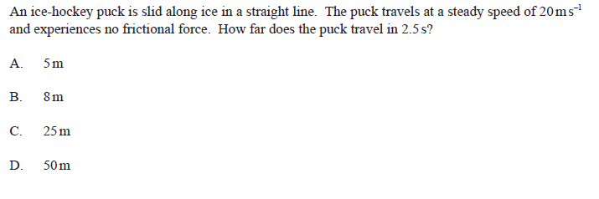
Easy one?

Slide 4
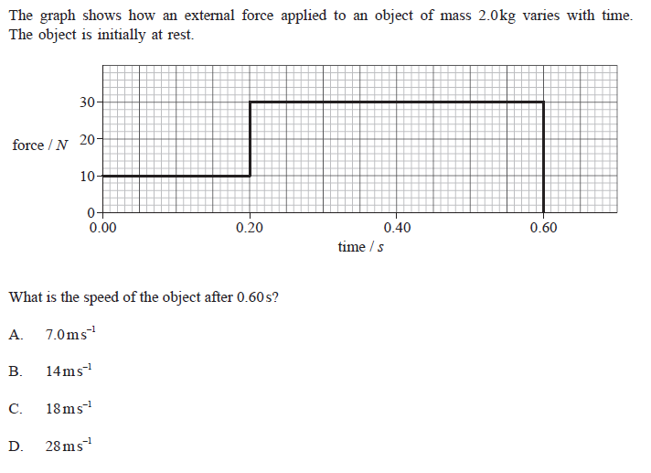
Acceleration

Slide 5
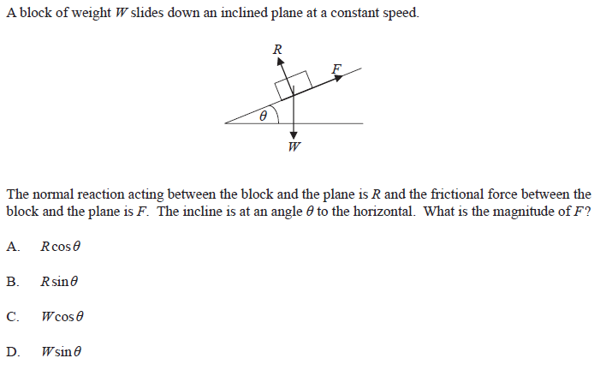
No resultant force

Slide 6
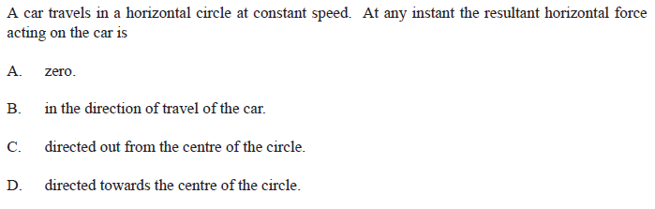
Resultant force

Slide 7
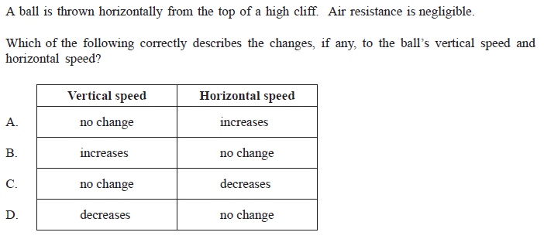
Projectile motion

Slide 8
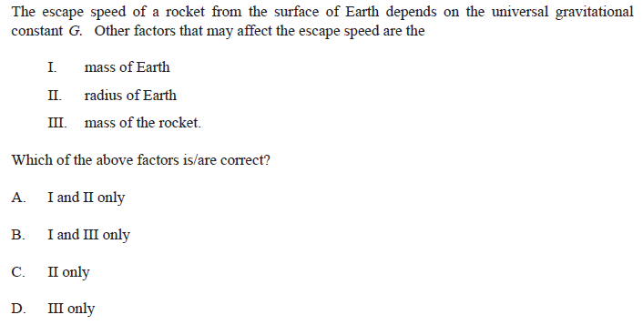
Escape velocity

Slide 9
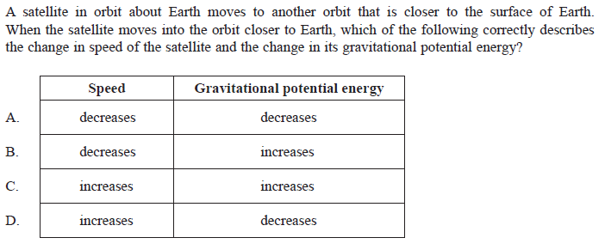
Orbits

Slide 10
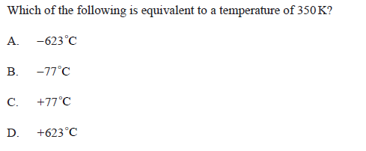
Kelvin Temperature

Slide 11
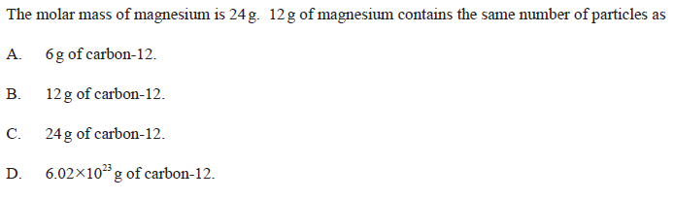
Molar mass

Slide 12
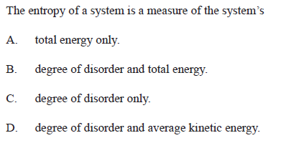
Entropy

Slide 13
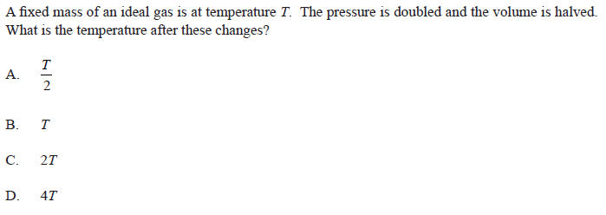
Gas laws

Slide 14
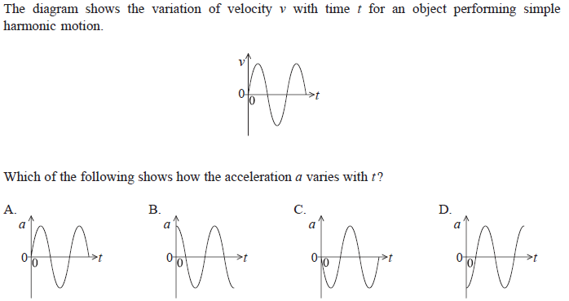
SHM

Slide 15
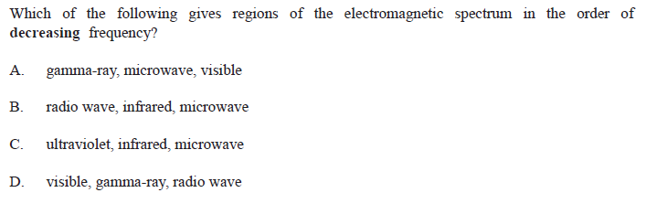
Electromagnetic spectrum

Slide 16
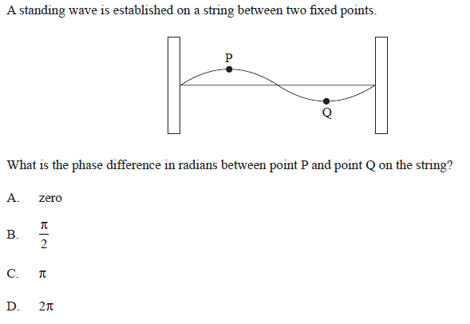
Standing wave

Slide 17
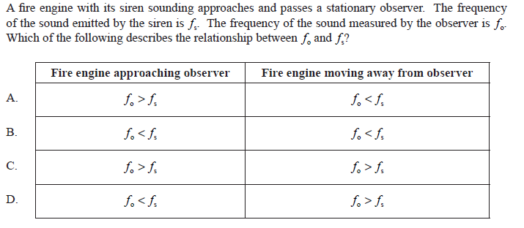
Doppler effect

Slide 18
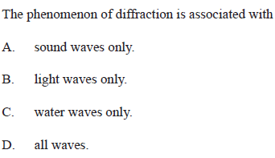
Diffraction

Slide 19
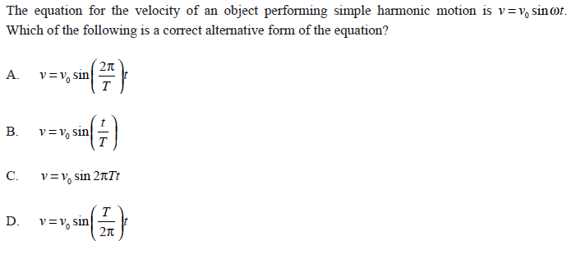
SHM 2

Slide 20
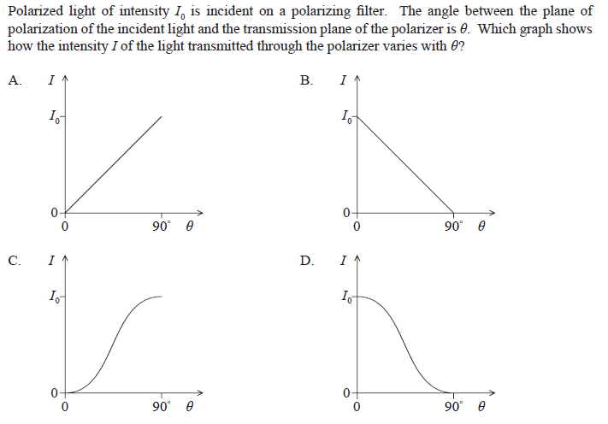
Malus’ law

Slide 21
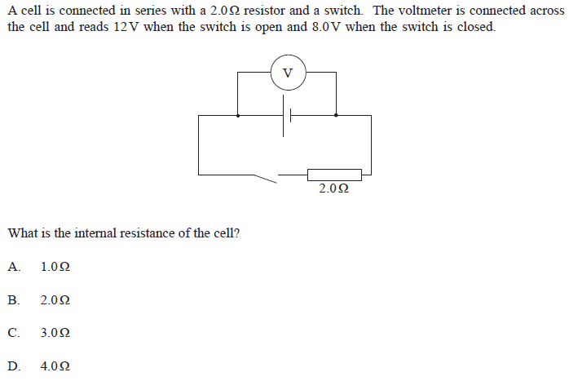
Internal resistance

Slide 22
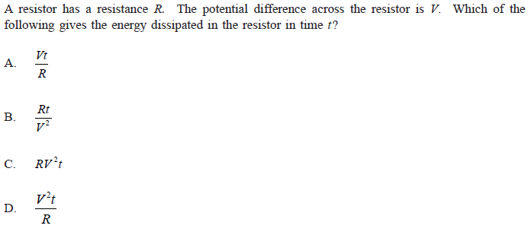
Electrical Power

Slide 23
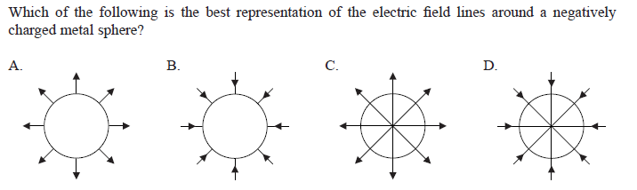
Electric Field

Slide 24
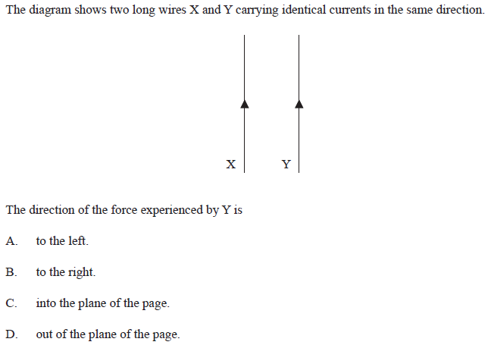
The Ampere

Slide 25
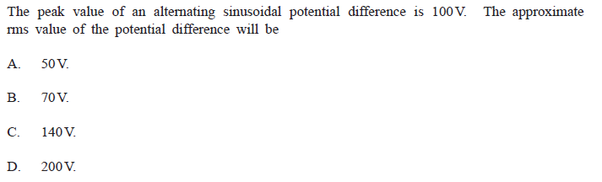
rms

Slide 26
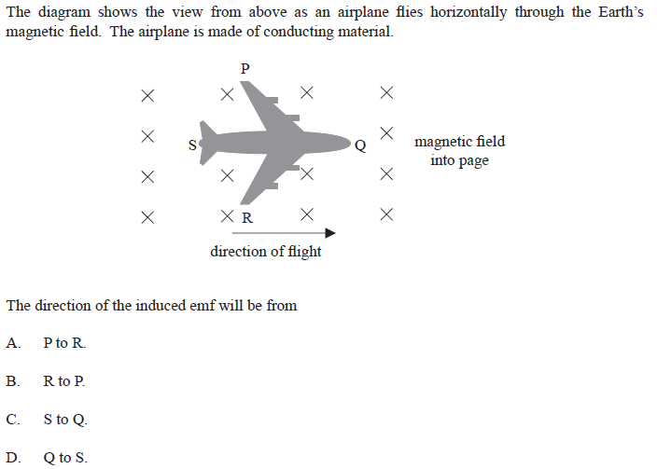
Induced emf
http://www.miniphysics.com/2010/11/emf-induced-in-straight-conductor.html

Slide 27
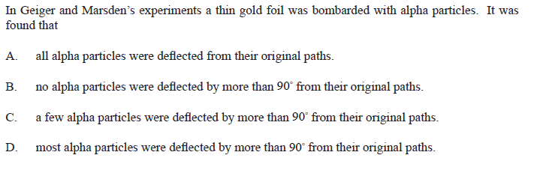
Alpha scattering
http://www.miniphysics.com/2010/11/emf-induced-in-straight-conductor.html

Slide 28
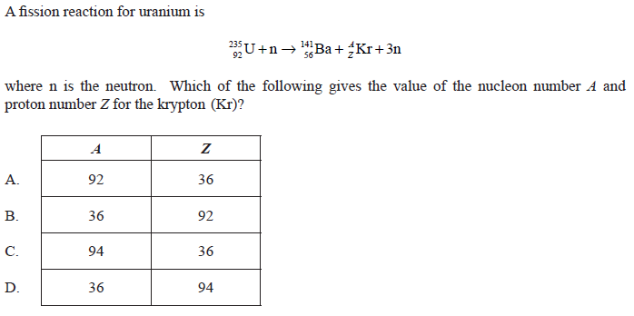
Fission
http://www.miniphysics.com/2010/11/emf-induced-in-straight-conductor.html

Slide 29
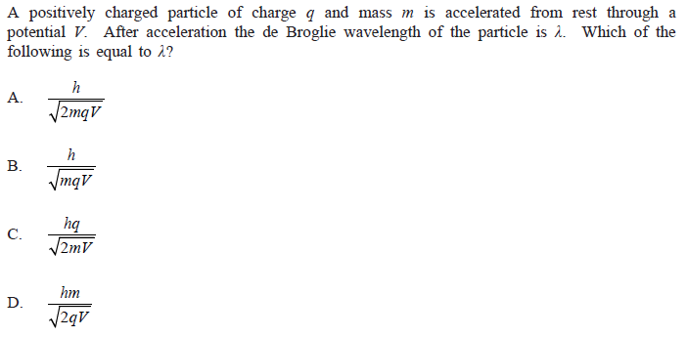
de Broglie wavelength

Slide 30
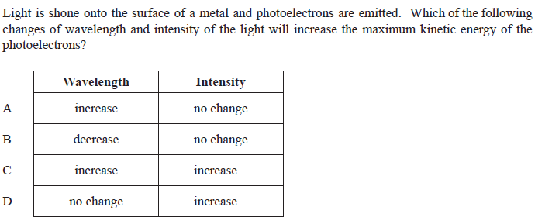
Photo-electric effect

Slide 31
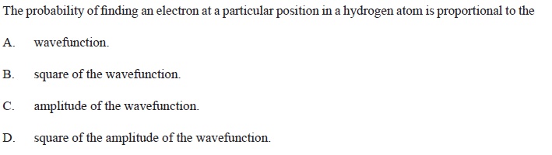
Schrodinger

Slide 32
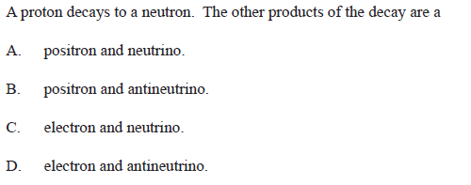
Proton decay

Slide 33
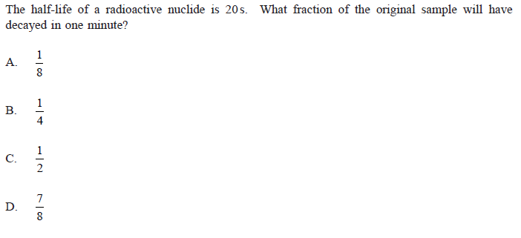
Half life

Slide 34
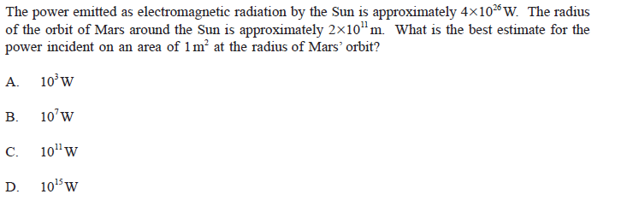
Intensity of sunlight

Slide 35
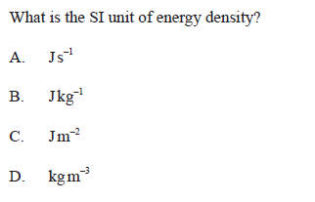
Si Units 2
or Jmol⁻¹ for Chemists

Slide 36
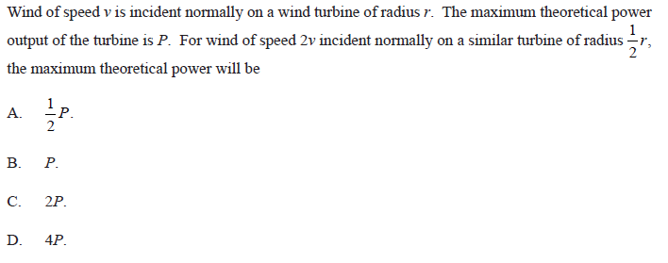
Wind power

Slide 37
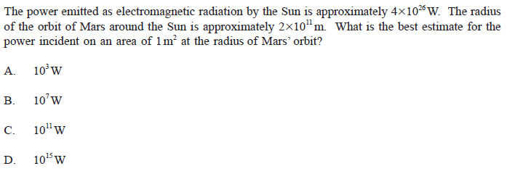
Sun power

Slide 38
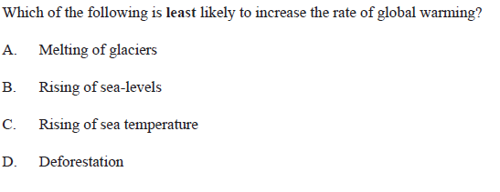
Global warming

Slide 39
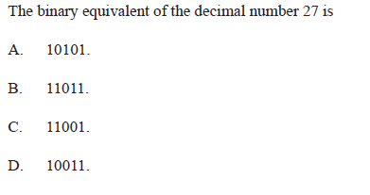
Binary

Slide 40
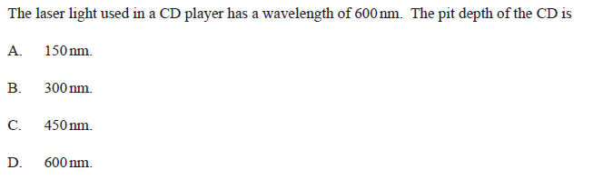
Pit depth

Slide 41
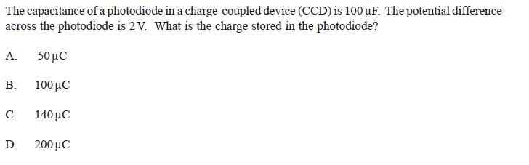
Capacitance

